Slide 1
Current Affairs

Slide 2
How to make a must listen to show
.
Martin Davies
Cassandra Johns
Eduardo Jordan

Slide 3
Only one place to start!
Know your audience.

Slide 4
What is the purpose of your show?

Slide 5
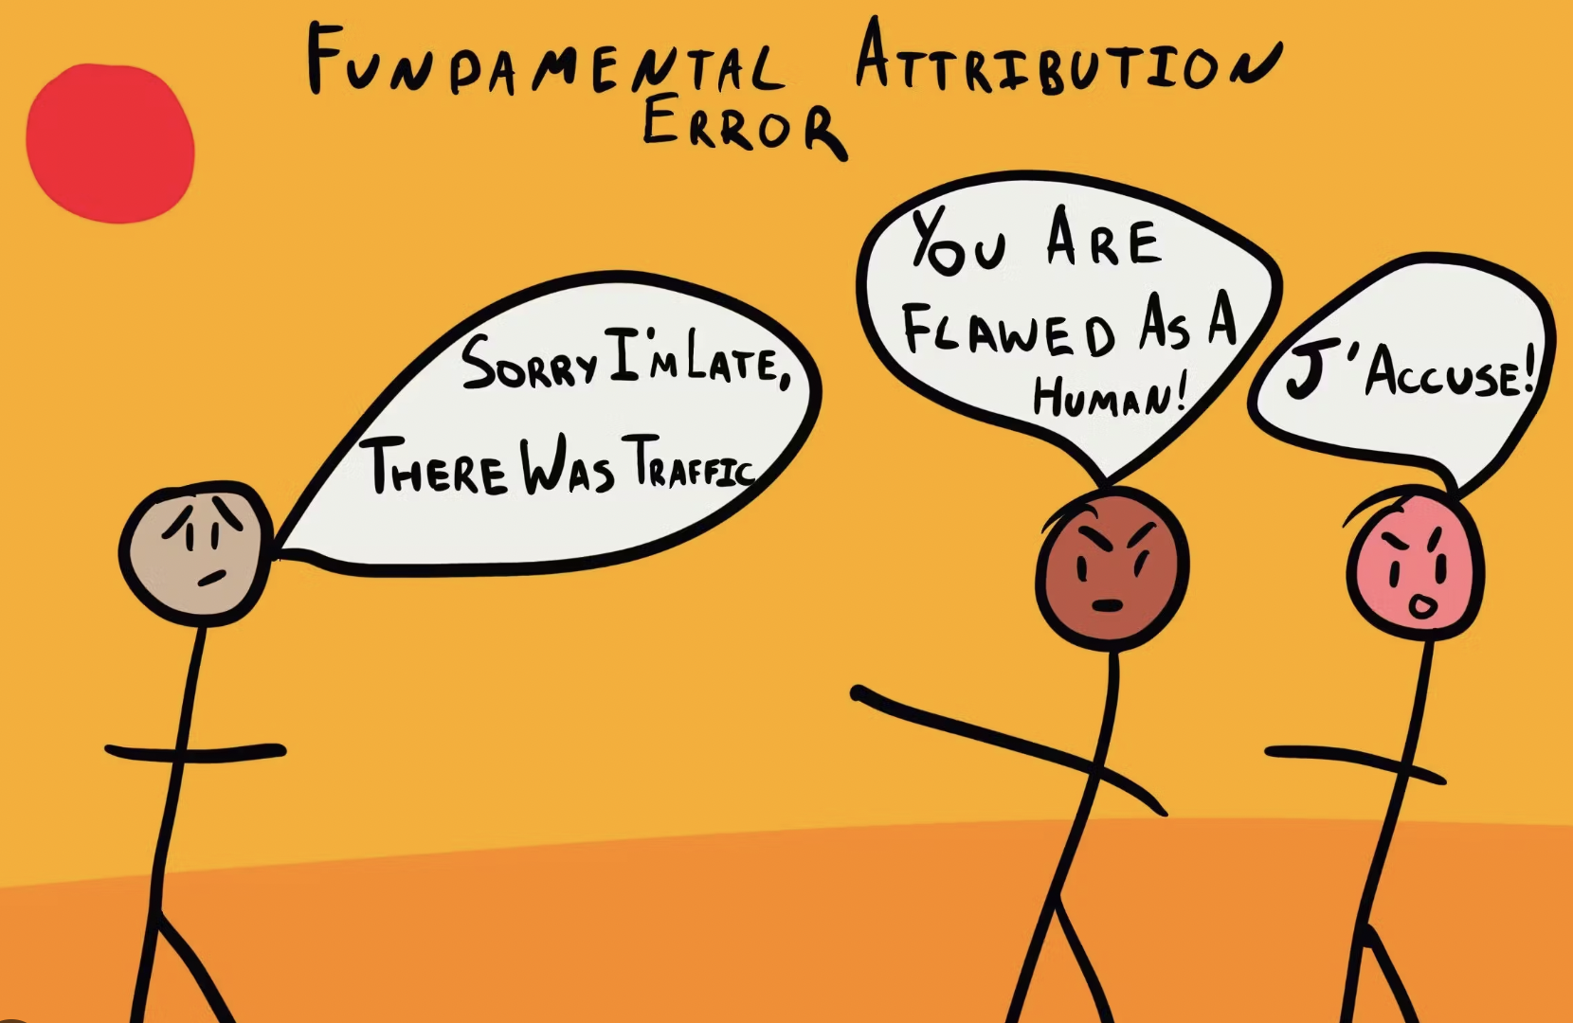
Attribution and balance.

Slide 6
The considerations around live or pre-record.

Slide 7
The advantages of pre-recorded items
The guarantee that you have the item
You know what they are going to say because they have already said it
So you can get more value from it
Take a grab for the top of your show
Trail and cross promote - perhaps using a grab or clip
You could include it in your news and share it with NRN
Each recorded element within a live show is like an island in an ocean.
Save “Live” for your own team members or those events that absolutely necessitate.

Slide 8
Producing great interviews:
Know your angle according to where we are with this narrative for our audience or overtly what we want from it?
Don’t start until you know the counterpoint to the angle you are taking
Listen intently
Ask for feelings
Present the other side of the story by attributing it in your questions
Look for descriptions
Don’t edit down but start with nothing and just put in the best bits.

Slide 9
Tips
Always think of your audience – place community at the heart.
What is the deal
Sign posting
Hooking and teasing
Cross Promoting
Keeping the volunteers happy

Slide 10
Formats
as she told River FM

Slide 11
Content surgery:

Slide 12
Current Affairs

