Slide 1
Strengthening Sponsorship at your Station

Slide 2
What will be cover today?
Current State of Direct Sales
How to be proactive
Workshop how you can do this at your station

Slide 3
Current State
Commercial Radio is investing less in direct sales, their focus is on agency.
Direct clients cannot afford the kind of campaigns they need on commercial radio to make an impact.
Do not offer anything outside of traditional radio.
Sales are based on emotive decisions not stats.

Slide 4
How to Be Proactive
Stop handing out rate cards, one size does not fit all
Understand your audience and their needs
Be creative and be strategic, what can you do differently that no one else is doing.
Include outdoor, online and digital

Slide 5
5 Steps
Understand: Who is your audience/community, what are their circumstances, what do they need.
Identify: Look for clients that meet your listeners needs.
Meet: with the sponsor to find out about their needs. Ask them about target audience, what success looks like, how much are they looking to spend
Strategies: What are some creative ways that your station can
Pitch: the client should have a tailored media kit that highlights how your station will help them achieve their goals because you have the right audience.

Slide 6
Now over to you

Slide 7
Client is a internet company wanting to target people 35-55 who find their home internet is too slow or who are working from home. They don’t want to hard sell but be seen as informative partner. There budget is 15k

Slide 8
CLINT MEDIA KIT

Slide 9
YOUR STATION is Business.
Our Listeners Make Business Decisions.
1 in 3
46%
29%
Our listeners made a business decision in the last 12 months. 39% Higher than National average
13 Hours
Radio & online content is consumer on average for each of our listeners weekly
Our listeners are Professionals / Managers
at a Small to Mediums sized business
more likely to be a Chairman or Managing Director compared to the national average
Source: GfK Survey 5 Data, 2019. Roy Morgan Single Source, Oct 18 – Oct 19

Slide 10
Campaign Objective.
STATION would be excited to partner with Summit Internet to drive awareness and promote the Summit brand among a passionate & sports loving audience.
By delivering a strong highly frequent message targeting business owners and decision makers, STATION will drive qualified traffic to Summit Internet.

Slide 11
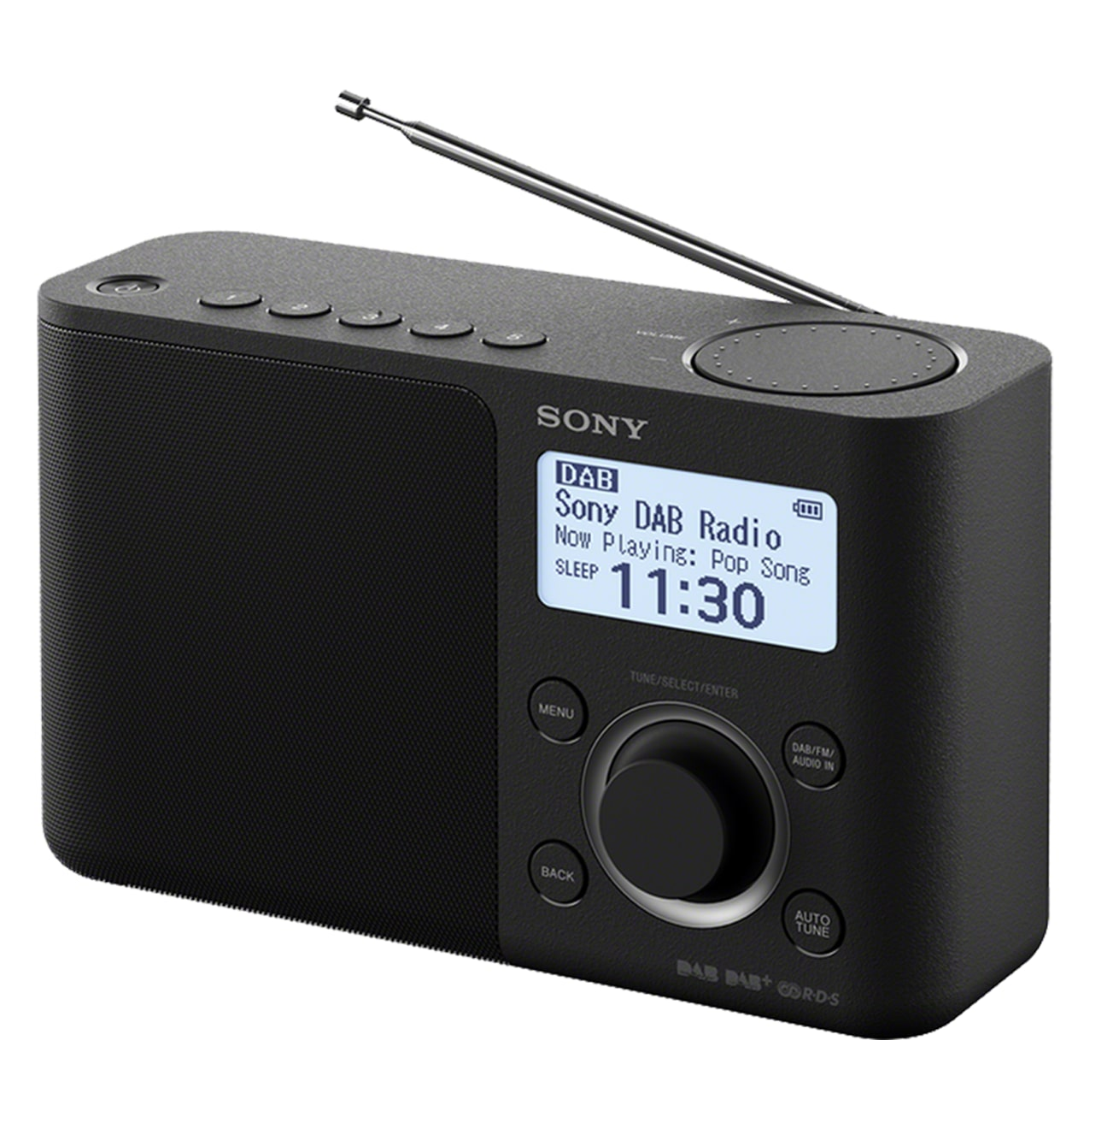
Media Strategy Options.
COMMERCIALS
LIVE READS
SPONSORSHIP
TARGETED DIGITAL

Slide 12
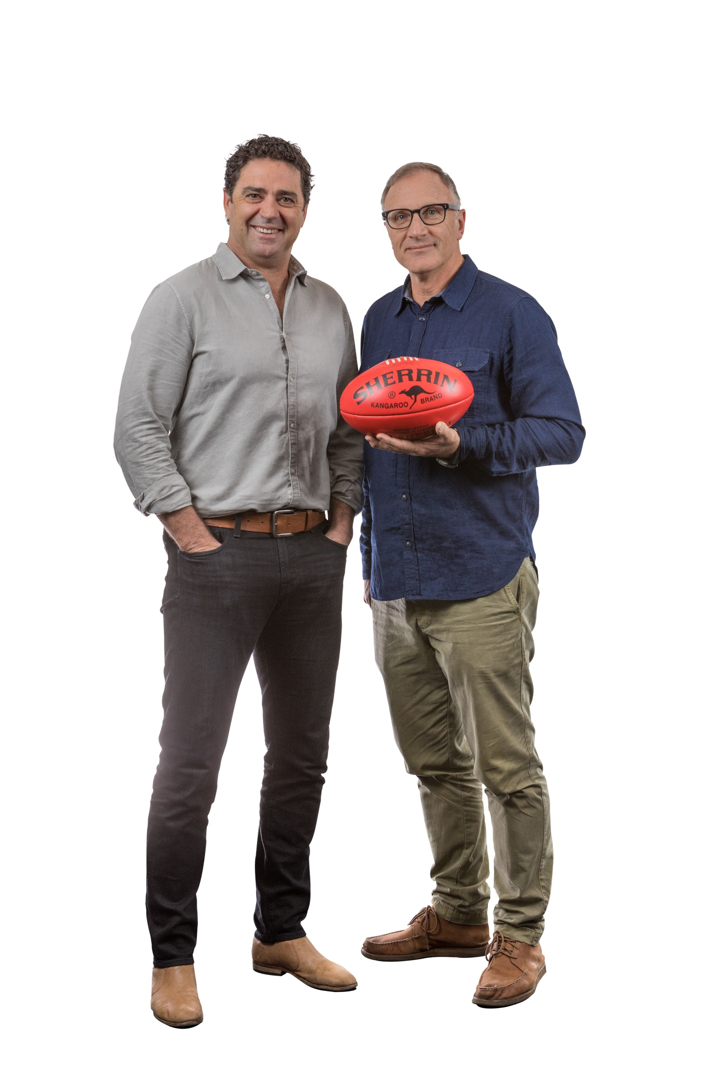
Live Reads - Breakfast
Garry & Tim deliver more analysis and insights on the stories that matter most to the Melbourne audience.
The benchmark when it comes to football experience, Garry and Tim’s expertise and insight sets the agenda each morning as they bring Melbourne the biggest names in both the AFL and sporting landscape.
Weekly contributors including Mike Sheehan, Nick Riewoldt, Daisy Pearce and Liam Pickering bring our listeners the news, rumours and sports updates they need to know, making SEN Breakfast the key radio and podcast destination for sport-loving Melbournians.
With 183,000* weekly listeners and the number #1 podcast Breakfast Show in Australia*, SEN Breakfast with Garry & Tim are up and about early from 6am – 9am Monday to Friday.
In 2020, we would like to offer Summit Internet a Live Read Partnership on SEN Breakfast with Garry and Tim to drive brand awareness for you through this highly engaged audience.
Weekly Entitlements:
1 x 30 Second Live Read

Slide 13
Podcast Pre-Rolls A Geo-Targeted Approach with Zero Wastage.
Capitalise on STATION NAME’S ability to geo-serve podcast pre-roll to all podcast platforms.
We can put a ringfence around the area that will best suit all ad inventory to ensure zero wastage and maximum potential conversion.
We can also target key times (hour, day), focus around live sport or shows that deliver the best strategic alignment.
Podcast Pre-rolls are a great way to provide massive cut-through prior to the podcast playing.
Podcasts are highlight targeted, giving you unprecedented access to our niche loyal and engaged sports loving audience.
Prior to each of our highly engaged podcast’s, Summit’s 15 second commercial will play, giving you access to the listeners undivided attention.
Monthly Entitlements:
20,0000 x 15 Second Pre-Roll Geo Targeted Ads
Notes:
AFL Nation can be heard each weekend of the season on 2HD.
More broadly is connects with over 600,000 fans each week across the country with play by play call of the biggest matches every weekend.
Our expert commentary team, lead by Chief Sports Caller – Gerard Whateley – are ready to deliver a superior broadcast call in 2019.

Slide 14
Weekly Media Plan – 3 Month Campaign.
 | DURATION | TIME SESSION | MONDAY | TUESDAY | WEDNESDAY | THURSDAY | FRIDAY | SATURDAY | SUNDAY | NO. | 4 Week Total
Recorded Commercials
Breakfast | 30 Sec | 6am – 9am | 2 | 2 |  |  |  |  |  | 4 | 52
Drive | 30 Sec | 3pm – 6pm | 2 | 2 |  |  |  |  |  | 4 | 52
AFL | 30 Sec | AFL |  |  |  | 2 |  |  |  | 2 | 6
Bonus | 30 Sec | 0:00am – 23:59pm | 4 |  |  |  |  |  |  | 4 | 52
Live Reads
Breakfast* 3 per month | 30 Sec | 6am – 9am | 1 |  |  |  |  |  |  | 1 | 10
Sponsorship
Drive Weather | 8 Words | 3pm – 6pm | 6 | 6 | 6 | 6 | 6 |  |  | 30 | 390
 |  |  |  |  |  |  |  |  |  | 43 | 562

Slide 15
Reach & Frequency– 3 Month Campaign.
Audience | Spots | Reach | Reach % | Ave Frequency | CPM
All People 10+ | 562 | 495,000 | 10.88% | 22.70 | $2.40
Men 25-54 | 562 | 203,000 | 18.18% | 24.08 | $5.60
Business Owners & Decision Makers | 562 | 74,000 | 18.72% | 27.19 | $13.60

Slide 16
Weekly Media Plan – 6 Month Campaign.
 | DURATION | TIME SESSION | MONDAY | TUESDAY | WEDNESDAY | THURSDAY | FRIDAY | SATURDAY | SUNDAY | NO. | 4 Month Total
Recorded Commercials
Breakfast | 30 Sec | 6am – 9am | 2 | 3 |  |  |  |  |  | 5 | 138
Drive | 30 Sec | 3pm – 6pm | 3 | 2 |  |  |  |  |  | 5 | 138
AFL | 30 Sec | AFL |  |  |  | 2 |  |  |  | 2 | 32
Bonus | 30 Sec | 0:00am – 23:59pm | 4 |  |  |  |  |  |  | 4 | 104
Live Reads
Breakfast* 3 per month | 30 Sec | 6am – 9am | 1 |  |  |  |  |  |  | 1 | 20
Sponsorship
Drive Weather | 8 Words | 3pm – 6pm | 6 | 6 | 6 | 6 | 6 |  |  | 30 | 780
 |  |  |  |  |  |  |  |  |  | 45 | 1212

Slide 17
Reach & Frequency – 6 Month Campaign.
Audience | Spots | Reach | Reach % | Ave Frequency | CPM
All People 10+ | 1,212 | 603,000 | 13.24% | 52.44 | $1.90
Men 25-54 | 1,212 | 242,000 | 21.67% | 55.74 | $4.50
Business Owners & Decision Makers | 1,212 | 88,000 | 22.13% | 63.98 | $10.80

Slide 18
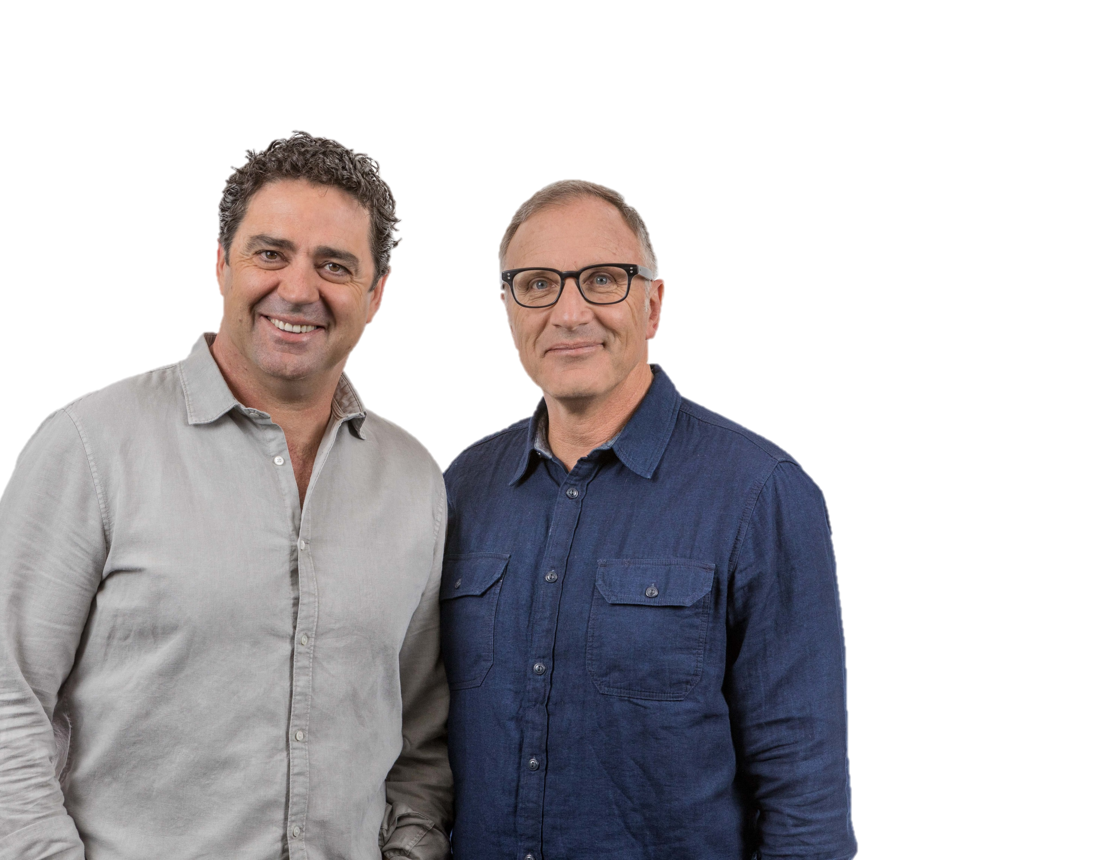
3 Month Investment Summary.
Activity across January 2019 – March 2020
Recorded Commercials
Live Reads with Garry & Tim
Sponsorships
Geo Targeted Podcast Pre-Roll
Test Cricket
$40,000 + GST

Slide 19
6 Month Investment Summary.
Activity across January 2019 – June 2020
Recorded Commercials
Live Reads with Garry & Tim
Sponsorships
Geo Targeted Podcast Pre-Roll
Test Cricket
$70,000 + GST

Slide 20
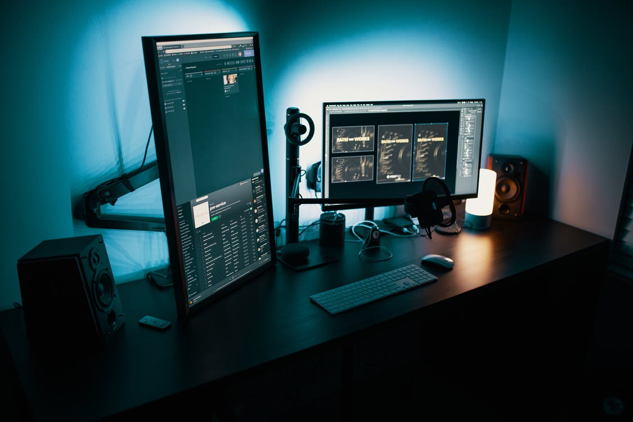
In Summary.
Along a campaign on 1116 SEN, we would target business owners and business decision makers looking for new or improved internet.
We will achieve this by using a schedule of recorded commercials, live reads, targeted sponsorships, and geo targeted Podcasts.

Slide 21
1116 SEN is Business.
Key Clients Targeting Business.
CLIENT | TYPE OF BUSINESS | COMMERCIAL FREQUENCY PER WEEK | SPONSORSHIP
Supple | Digital Marketing Agency | 25 + | Traffic Sponsorship in Breakfast & Drive
Prospa Advance | Business Loans | 20 + | Multiple burst partnerships – N/T/W
On Deck Capital | Business Loans | 20 + | Afternoons Naming
Bizcover | Business Insurance | 15+ | Multiple burst partnerships – N/T/W
Lead Express | Lead Generation | 10+ | No
Boom Sales | Sales Training | 10+ | No

Slide 22
MEET THE 1116 SEN & SEN+ LISTENER
Male Aged 25-44
Married with children
Kids under 18
Home Owners
Travels
23km to work
Half work in inner Melbourne
Household income over $150,000
Over index for
construction industries & financial services
WE ARE
Source: Roy Morgan Single Source, Jul 18 – Jun 19

Slide 23
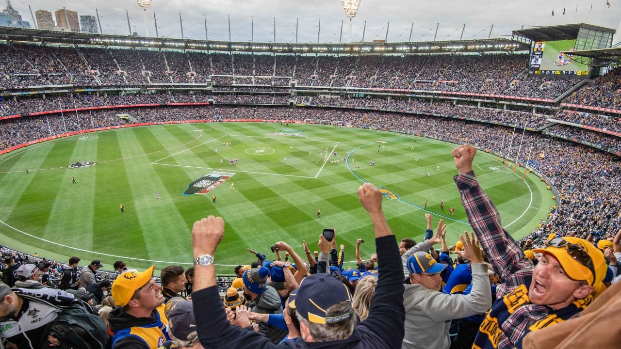
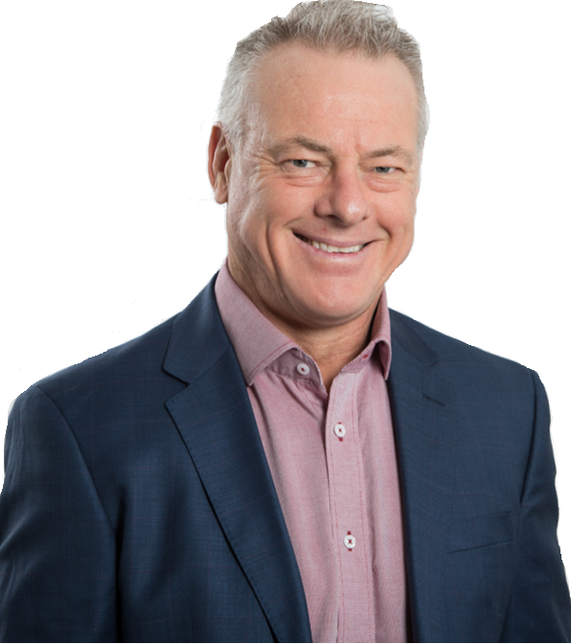
MONDAY – FRIDAY
MELBOURNE’S HOME OF SPORT
GARRY & TIM
WHATELEY
KANE CORNES
DWAYNE RUSSELL
ANDY & BOB
SAM McCLURE
BREAKFAST
MONDAY - FRIDAY
6AM-9AM
MORNINGS
MONDAY - THURSDAY
9AM-12PM
MORNINGS SEN SA
MONDAY – FRIDAY
FRI MORNINGS SA & MELBOURNE
6AM – 8:30AM
AFTERNOONS
MONDAY - FRIDAY
12PM-3PM
THE MATCH COMMITTEE
DRIVE
MONDAY - THURSDAY
3PM – 6PM
THURSDAY 6PM-7PM
TIME ON
MONDAY - WEDNESDAY
6PM-7PM
360,000
weekly listeners
Source: GFK Radio Ratings, Survey 5 2019

Slide 24
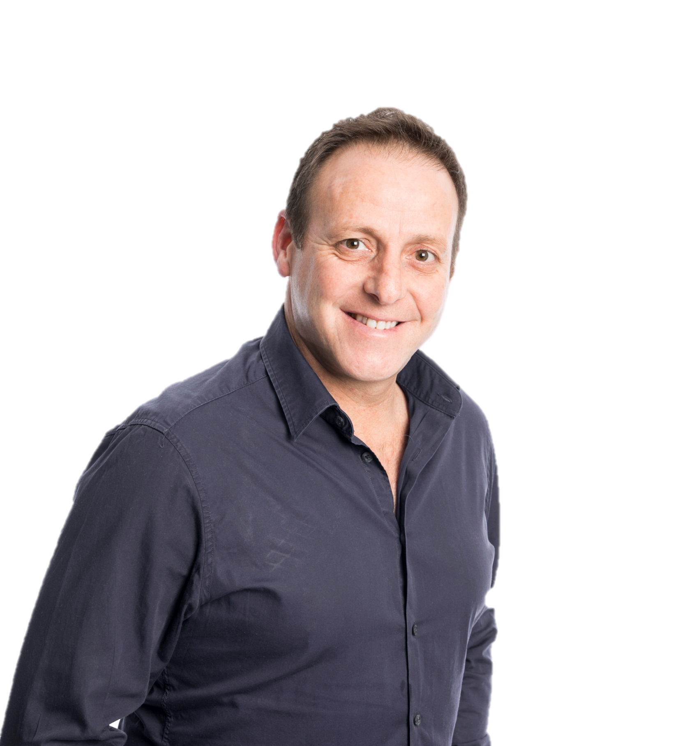
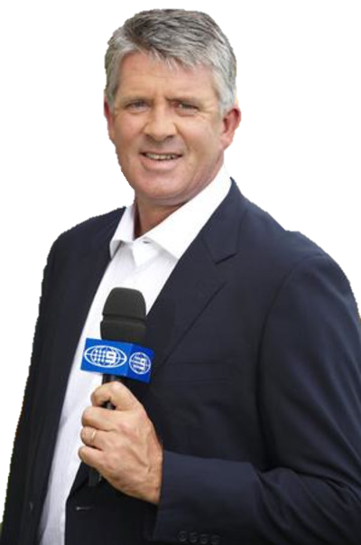
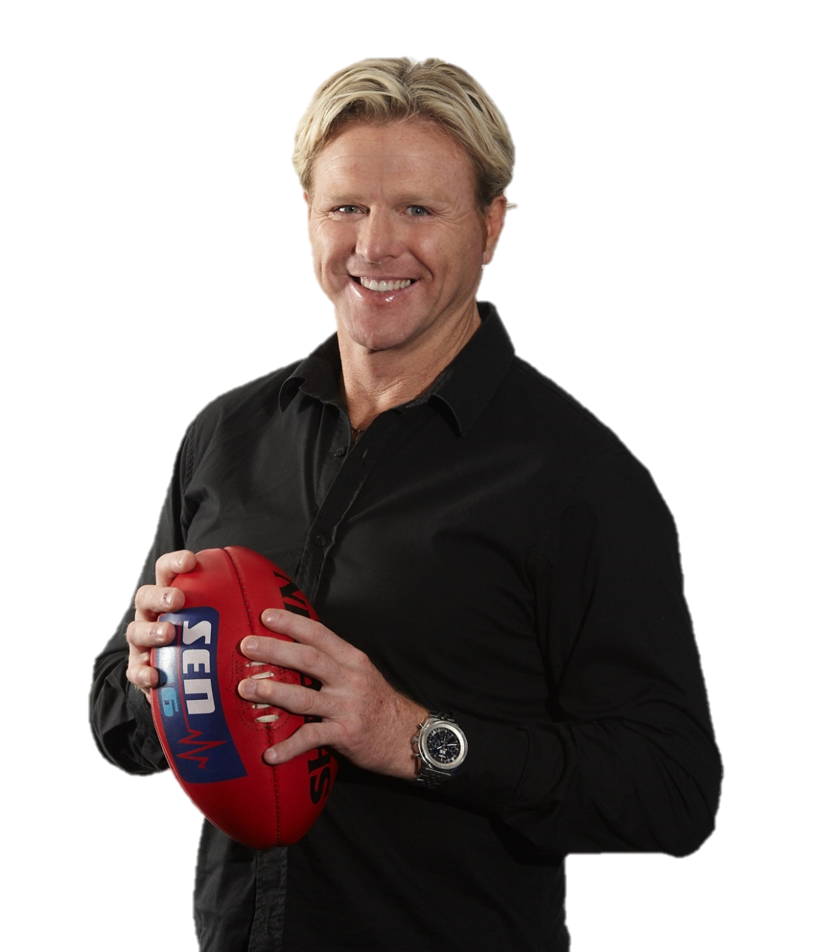
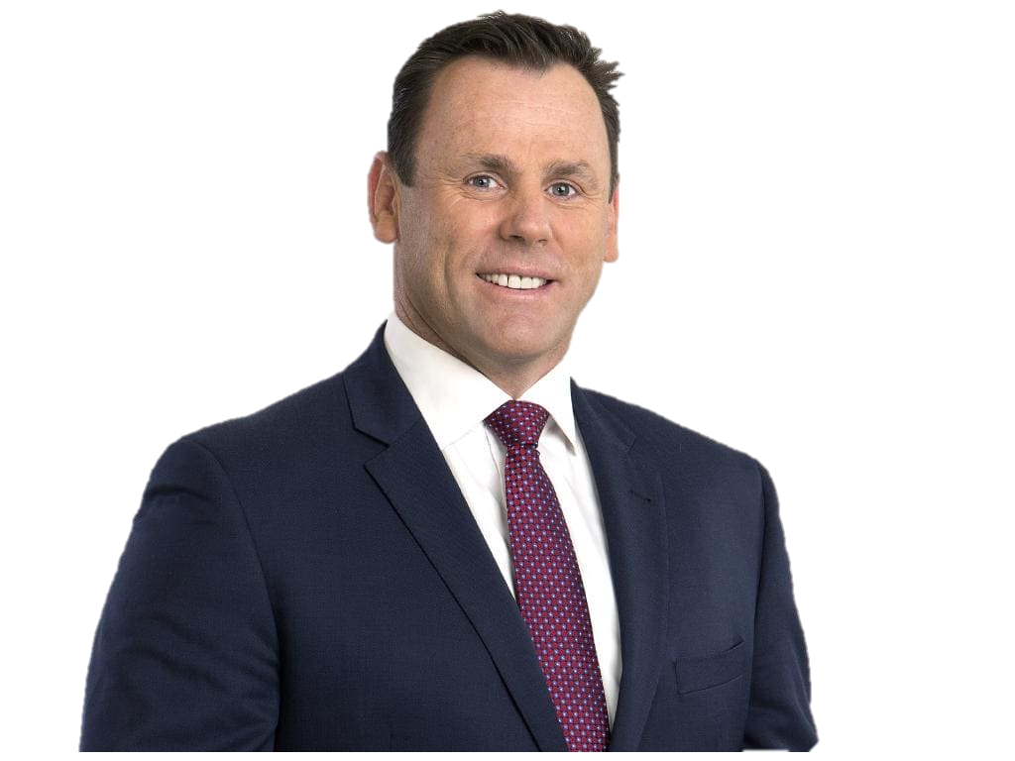
MELBOURNE’S HOME OF SPORT
SATURDAY
REEL ADVENTURES | THE ODDS COUPLE | OFF THE BENCH | CRUNCHTIME
7AM-8AM
8AM-9AM
10AM-11AM
11AM-1PM
PLUS LIVE SPORT BROADCASTS:

Slide 25
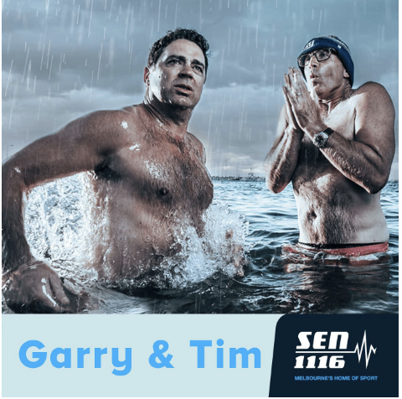
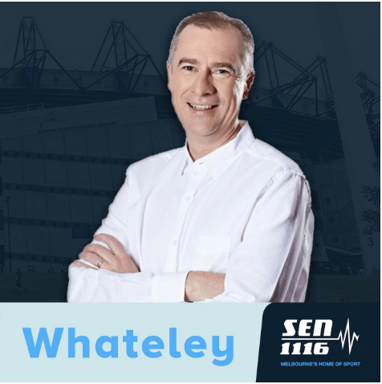
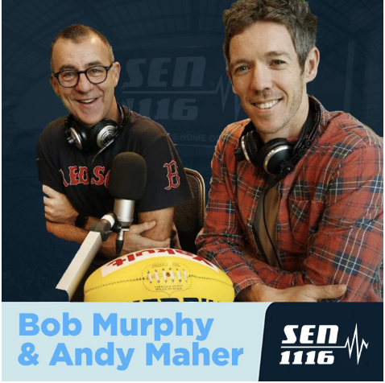
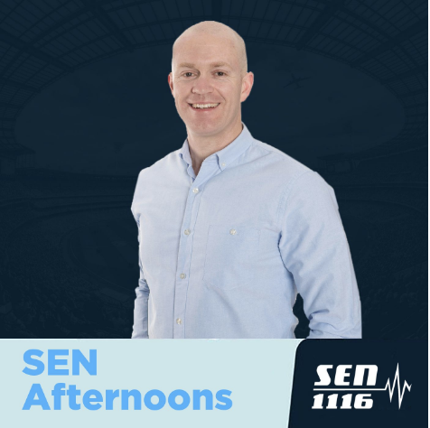
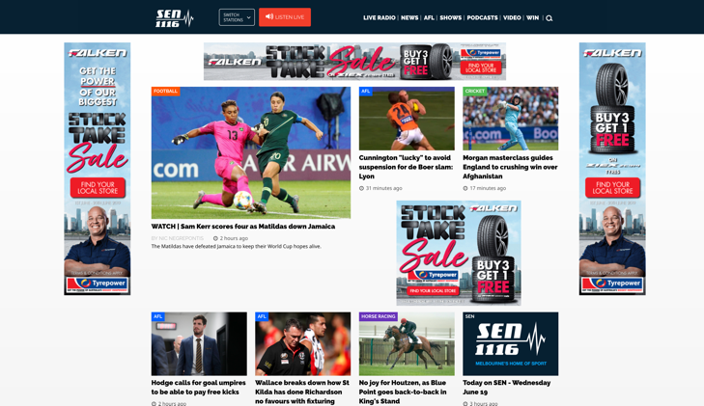
YTD 2019 SEN Digital Snapshot*
10.6M
36.9M
Total podcast listens
App Screen views
11.2M
App audio streams
197.5K
App users
3.1M
3.16M
141.3M
Unique listens
Unique listens
Concurrent minutes listened
29.9M
Site page views
3.5M
Unique visitors
2.1M
581.8K
457.2K
Web audio streams
Unique listens
Unique listens
*Figures for the period 01/01/2019 to 04/11/2019

Slide 26
THANK YOU
Declan Kelly
0406 917 768 Declan.Kelly@Crocmedia.com

Slide 27
Closing slide heading
Closing slide contact information

