Slide 1
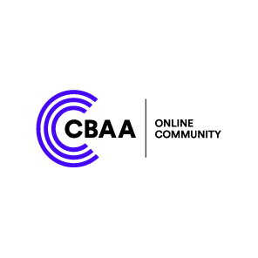
Head over to the CBAA Online Community
Keep the discussion going! Connect with other broadcasters and access resources on the Online Community after the conference.

Slide 2
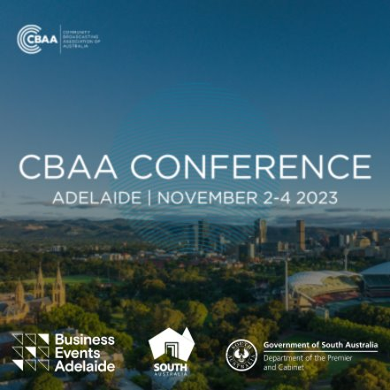
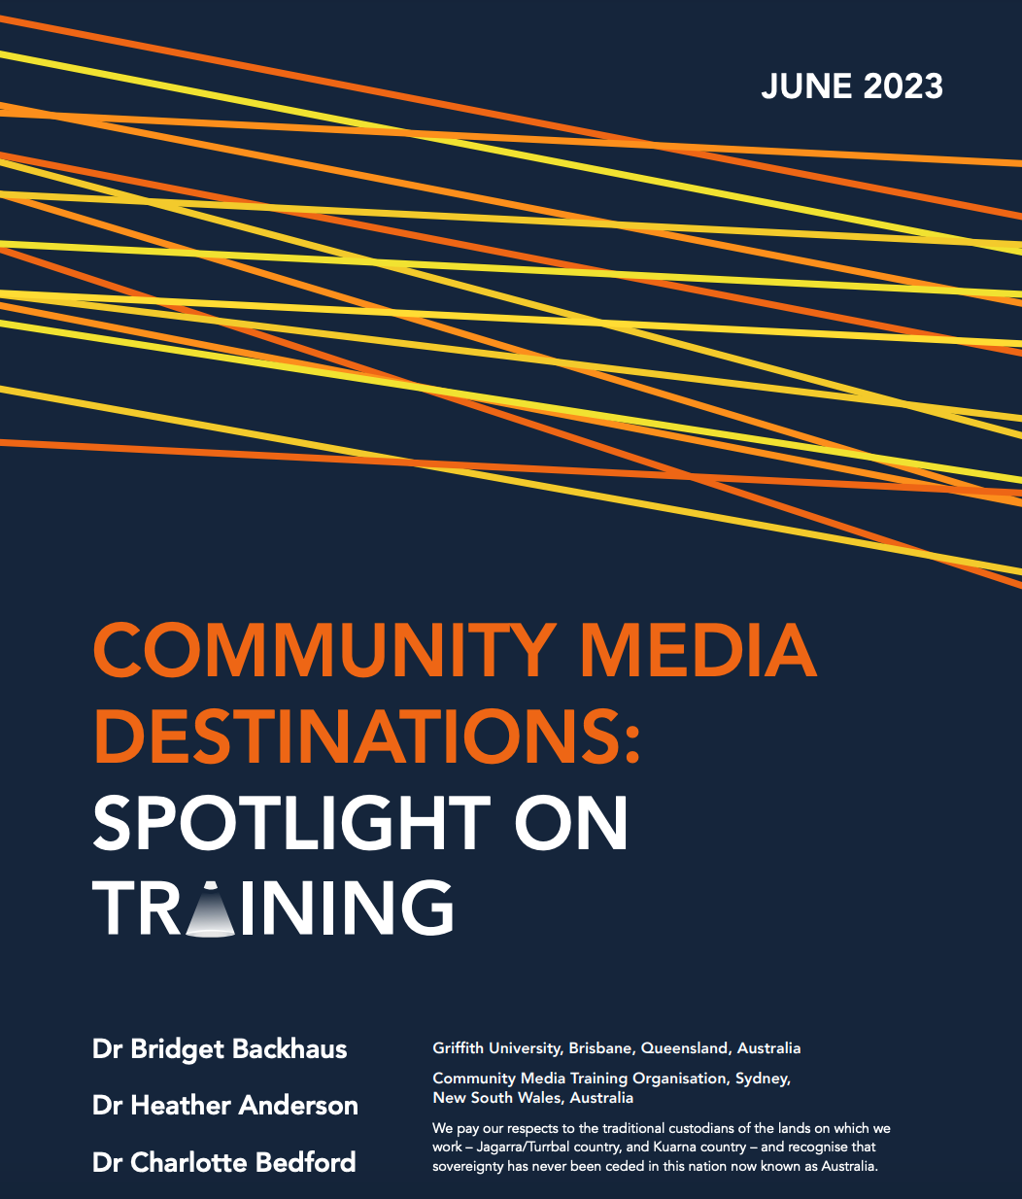
Community media destinations: spotlight on training
Dr Charlotte Bedford
Dr Bridget Backhaus
Dr Heather Anderson

Slide 3
We acknowledge the Kaurna people of Tarndanya
(the Adelaide Plains) and pay respect to their Elders both past and present
Notes:
Before we begin, we’d like to aWe acknowledge the Kaurna people of Tarndanya and pay respect to their Elders both past and present
We recognize this country now known as Australia is a colonized nation and sovereignty has never been ceded by the original inhabitants.
We’d also like to pay respects to the Jagarra and Turrabul people, who’s land we live and work on
And to the custodians of the other places we visited for our research,
the Wiradyuri people in Bathurst,
The Gadigal of the Eora Nation in Sydney and the Ngunnawal people in Canberra.
We acknowledge the integral role played by First Nations broadcasters
in helping to establish and sustain the community radio sector in Australia
And extend that thanks to any First Nations broadcasters with us today

Slide 4
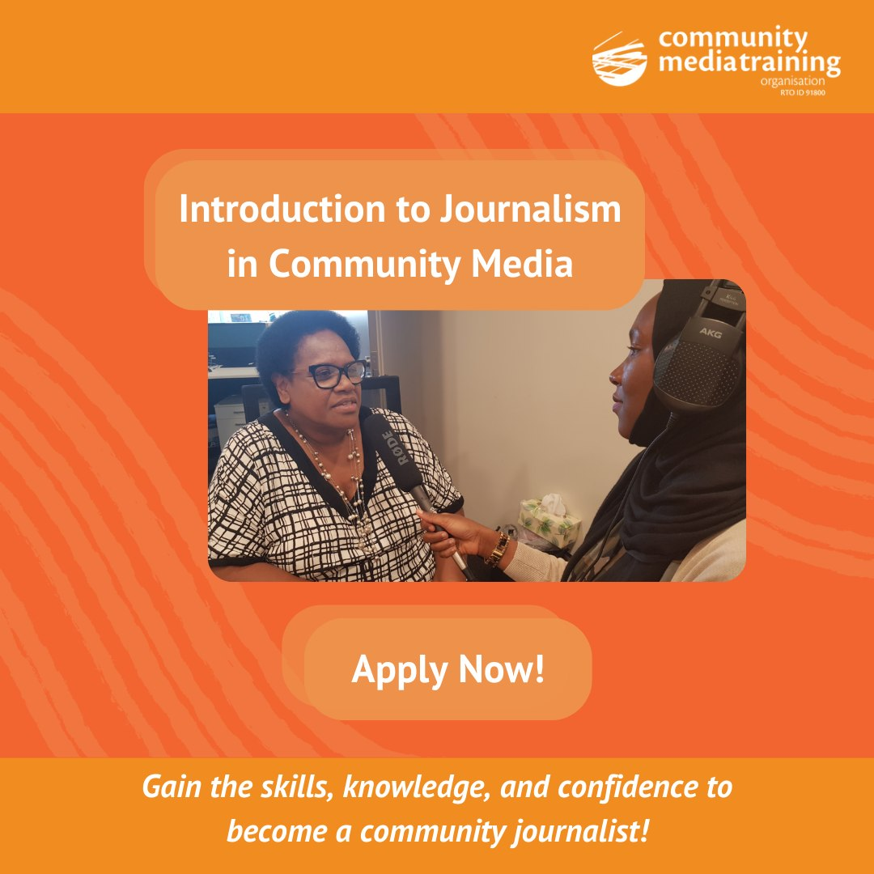
Community Media Destinations Project
In collaboration with the Community Media Training Organisation (CMTO - peak body for training in community media in Australia).
To better understand the impacts of community media training on the employment pathways, career trajectories and professional/personal development of its practitioners.
Two phases/reports
Community media destinations: spotlight on creative industries (2021 pilot)
Community media destinations: spotlight on training (2023)
Notes:
This report outlines the impacts of community media training on the employment pathways and career trajectories of its practitioners. Training has been integral to the growth of community broadcasting in Australia and continues to play a vital role in the sector. The focus on training within community media has broader societal effects: community media is increasingly recognised as a key training ground for media, creative and cultural industries in Australia. While training and career development are important goals and outcomes for some participants, it is important to also acknowledge that people volunteer in the community broadcasting sector for a plethora of motivations besides wanting to further their career. As such, this research explores the role of training not just in terms of career development but also more holistically.

Slide 5
Method
Phase One (pilot)
Six in-depth interviews
creative industries practitioners who got their start in community broadcasting
Phase Two
Survey
targeting anyone who had engaged in any form of CMTO training
demographic data, information about courses completed, employment/volunteer activities, role of the CMTO training on professional/personal development
79 respondents
In-depth interviews
25 semi-structed interviews; average length just under 32 mins
guiding questions informed by pilot research findings
Theoretical approach of community media as rhizome (Bailey et al., 2007)

Slide 6
Key findings:
Career pathways
Skills development
Access to opportunities
Importance of training
Social justice and values
Burnout and mental health
Networks and community

Slide 7
Professional networks and networking
‘I was presenting at <community media outlet> and … I got a call from an old colleague of mine…. And she reached out to me, and she said, “hey, look, I've been consulting for <organisation>…. I've given them some ideas, they really like it. They've asked me to kind of come and join them full time. This opportunity is real. I want you to be part of it. What do you think?”’

Slide 8
Friendships and social connections
‘Through community media … I've met so many amazing people and made so many amazing connections that made me feel really connected to not just my mob, but mobs across the country. So, for me that's been the biggest, the connection to community.’

Slide 9
Relationship building across difference
‘So many different people are involved in community radio that you meet all walks of life … because we would have everyone from Malcolm Turnbull [former Australian Prime Minister] to, you know, the high school student that just wants to get some work experience in the office and I think that's given me a really great foundation for relationship-building and I think it's really crucial in anything I do.’
Notes:
Relationship building across difference
Diversity is a key strength of Australian community media.
It is also central to the guiding rationale of the sector
Our findings offer some insight into the importance of participation in community media for expanding social and professional networks beyond usual circles.
One participant noted that the ability to communicate and build relationships with diverse groups and individuals was a crucial and highly transferrable part of her professional skillset. This was a common observation across several participants
Interacting with people of different lived experiences was important both in terms of developing skills and relationships, but also in learning about and connecting with unfamiliar stories and histories.
The ability to form relationships across difference and connect with issues removed from one’s own lived experience has influenced and informed participants’ personal and professional lives.
If community media truly is the training ground for the mainstream media, this may have greater impacts on Australia’s media landscape which is distinctly lacking in diversity

Slide 10
Conclusions
Community media contributes to professional and personal networks that have impact beyond the immediate scope of participation
Professional networks and networking skills were seen as a key benefit
Space for establishing rich, diverse, and enduring friendships
Participants form relationships across difference and connect with issues removed from their own lived experiences
Notes:
Networks in and of themselves are of tangential importance to this particular research project.
More significant is the importance assigned to these networks by the people and organisations involved in community broadcasting.
As such, viewing this research through the theoretical approach of community media as rhizome offers a rich conceptual underpinning to explore the interconnections of relationships within and across the communities of community broadcasting.
The development of professional networks and of professional networking skills were seen by participants as a crucial benefit derived from their participation in community media.
In addition to establishing professional relationships and networks, community media is also an important space for establishing and maintaining social connections and friendships.
Further, the networks, both social and professional, established and maintained through community broadcasting were richer and more diverse.
The ability to form relationships across difference and connect with issues removed from one’s own lived experience had profound influences on participants’ personal and professional lives.
The findings of this research clearly demonstrate that participation in community media has invaluable benefits for those involved, from professional networks to lifelong friendships.
These robust and meaningful networks, connections, and relationships are, in turn, central to shaping personal and professional pathways.

Slide 11
Full report: Community Media Destinations: Spotlight on Training

Slide 12
Head over to the CBAA Online Community
Keep the discussion going! Connect with other broadcasters and access resources on the Online Community after the conference.

